Slide 1
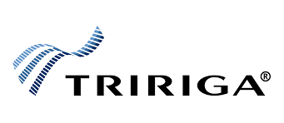

Intelligent Project Support Chatbot for TRIRIGA Implementation
AI-Enhanced Multi-Step Energy Usage Forecasting (AI-EMEU)
GIC Gen AI: Techathon 2023
GIC Gen AI: Techathon 2023
Nitin DH | IBM Consulting India | E- nhambir1@in.ibm.com | Direct - +91-9758914444.
Nitin DH | IBM Consulting India | E- nhambir1@in.ibm.com | Direct - +91-9758914444.

Slide 2
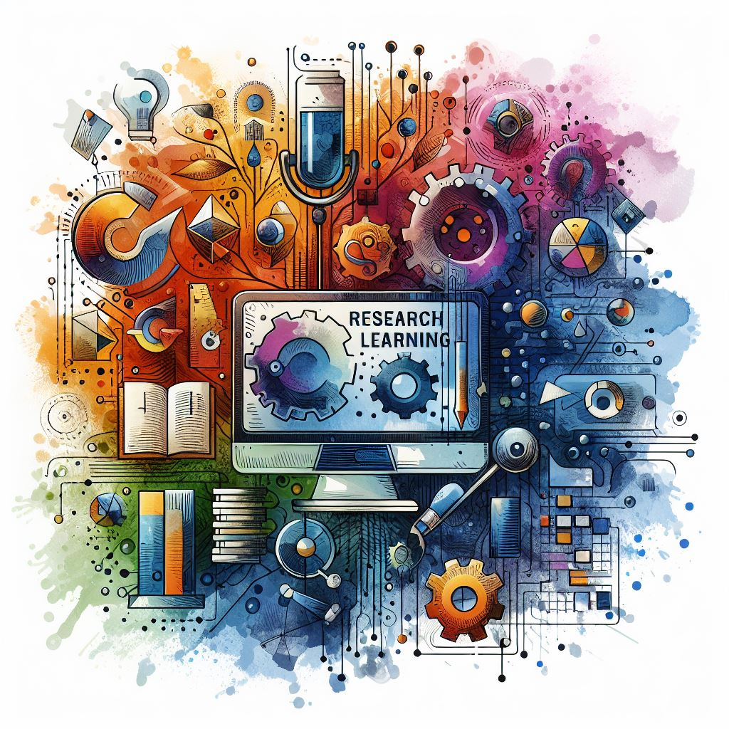

Intelligent Project Support Chatbot for TRIRIGA Implementation
The primary goal of this use case is to leverage advanced technologies, including Watson Discovery and Object Storage, to create a private AI -powered chatbot that enhances project support during and post-TRIRIGA implementation. The chatbot aims to streamline user interactions, provide quick access to documentation, and facilitate efficient support for Real Estate Lease, Capital Project, Facility Project, Energy Management, and Facility Management modules.

Slide 3

Intelligent Project Support System / Chat for TRIRIGA Implementation
Actors:
End Users: Individuals involved in the TRIRIGA project, including developers, testers, implementers, and support staff.
Development Team: Team responsible for the implementation, development, testing, and handover of TRIRIGA modules.
Project Stakeholders: Individuals overseeing the TRIRIGA project, including project managers and clients.

Slide 4

1 Requirement Gathering and Discovery Session:
Activity: Project initiates with a comprehensive requirement gathering and discovery session.
Artifact: Requirement specifications documented in JIRA tickets and technical documentation.
2 Development Phase:
Activity: Development team initiates module development based on documented requirements.
Artifact: Development progress tracked through JIRA tickets and technical documentation.
3 Testing and UAT Testing:
Activity: Modules undergo rigorous testing and User Acceptance Testing (UAT).
Artifact: Testing scenarios, results, and UAT feedback documented in JIRA and technical documentation.
4 Documentation and Object Storage:
Activity: Comprehensive documentation, including JIRA stories, requirements, and solutions, stored in Object Storage or Watson Discovery.
Artifact: Centralized repository of project documentation.
5 Project Handover:
Activity: Completed modules are handed over to the client after successful testing.
Artifact: Finalized modules, documentation, and handover protocols.
6 AI-powered Chatbot Integration:
Activity: Develop a private AI-powered chatbot using Watson Discovery and Object Storage.
Artifact: Chatbot trained on project-specific data, including JIRA stories, requirements, and solutions.
7 User Training Optimization:
Activity: GPT-powered chatbot utilized to provide on-demand information, reducing the need for extensive user training.
Artifact: Reduced training time, improved user support, and increased user satisfaction.
8. Post-Implementation Support:
Activity: GPT-powered chatbot continues to provide real-time support for queries related to TRIRIGA modules.
Artifact: Continuous improvement of the chatbot based on user interactions and feedback.
9. Expected Benefits:
Efficiency: Streamlined communication and reduced dependency on extensive training.
Accuracy: GPT-powered chatbot ensures accurate and context-specific information retrieval.
Time Savings: Quicker access to project documentation and resolutions.
10. Success Criteria:
Reduction in Training Time: Achieve a significant reduction in user training time.
User Satisfaction: Positive feedback and increased user satisfaction.
Query Accuracy: High accuracy in providing relevant information to user queries.

Slide 5
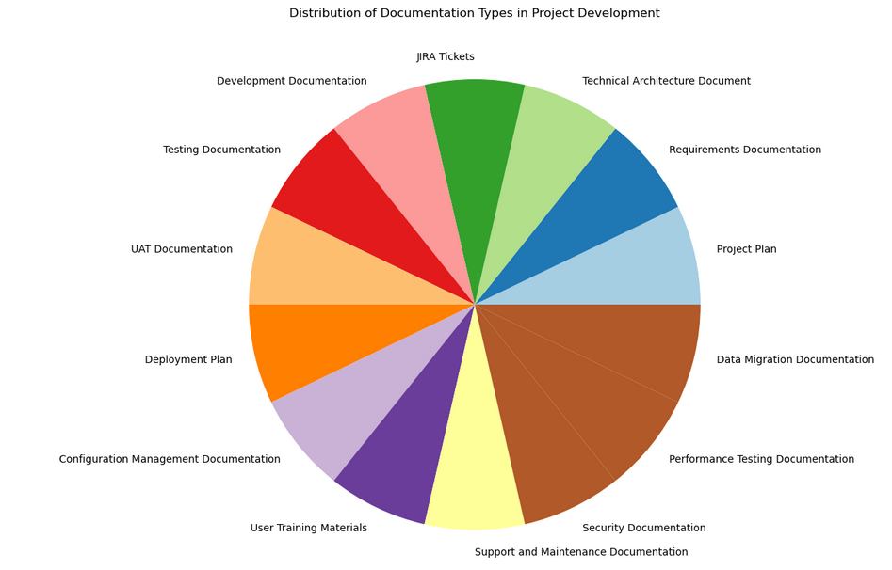
Distribution of Documentation Types in Project Development

Slide 6
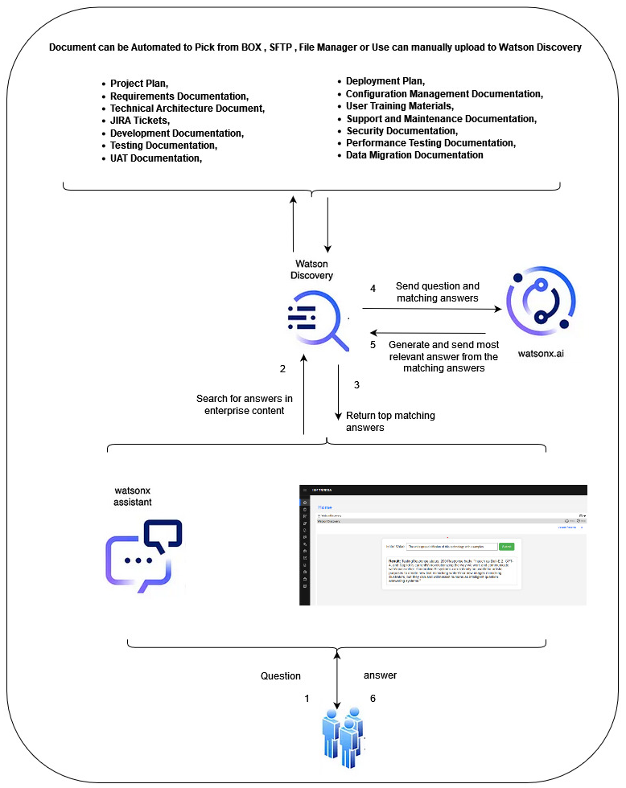
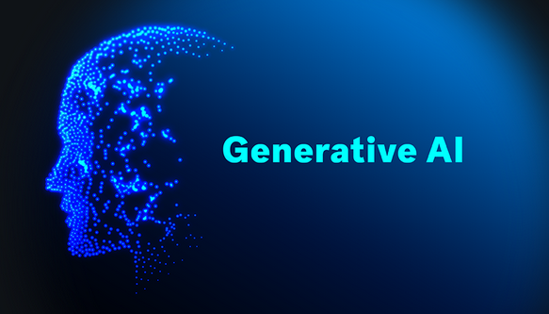
Distribution of Documentation Types in Project Development

Slide 7
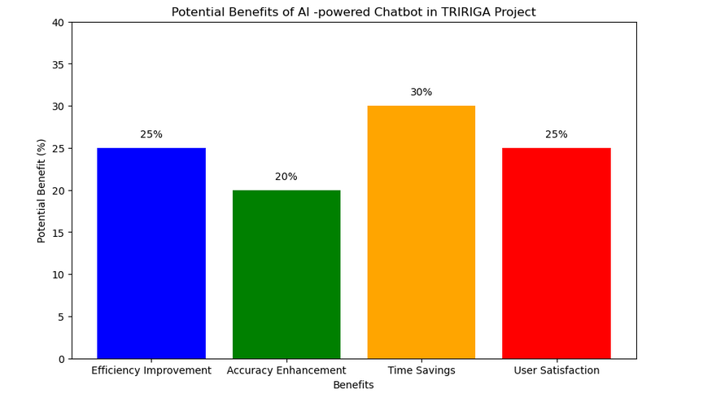
Intelligent Project Support Chatbot for TRIRIGA Implementation
Benefits:
Efficiency Improvement:
Potential Benefit (%): 20-30%
Explanation: The streamlined communication and reduced dependency on extensive training can lead to a significant improvement in overall project efficiency.
Accuracy Enhancement:
Potential Benefit (%): 15-25%
Explanation: The use of a AI -powered chatbot ensures accurate and context-specific information retrieval, reducing the chances of errors.
Time Savings:
Potential Benefit (%): 25-35%
Explanation: Quicker access to project documentation and resolutions can lead to substantial time savings during the project lifecycle.
User Satisfaction:
Potential Benefit (%): 20-30%
Explanation: Positive feedback and increased user satisfaction contribute to a more positive project experience.

Slide 8
Business Outcomes/ Benefits (along with any KPIs)
Reduced Training Time:
KPI: Average time spent on user training sessions.
Outcome: A decrease in the time required for user training sessions indicates the effectiveness of the chatbot in providing quick and accessible information.
Improved User Productivity:
KPI: User engagement metrics and productivity measures.
Outcome: An increase in user productivity and engagement as a result of streamlined communication and reduced dependency on extensive training.
Enhanced Accuracy in Support:
KPI: Accuracy of responses provided by the chatbot.
Outcome: Improved accuracy in providing relevant and context-specific information, reducing errors and enhancing overall project support.
Faster Issue Resolution:
KPI: Average time taken to resolve user queries.
Outcome: A decrease in the time required to resolve user queries indicates the chatbot's efficiency in providing quick solutions, contributing to faster issue resolution.
Increased User Satisfaction:
KPI: User satisfaction surveys and feedback.
Outcome: Positive feedback and higher satisfaction scores demonstrate the effectiveness of the chatbot in meeting user needs and expectations.
Efficient Documentation Management:
KPI: Accessibility and utilization of project documentation.
Outcome: Improved efficiency in managing and accessing project documentation, ensuring that relevant information is readily available for project stakeholders

Slide 9
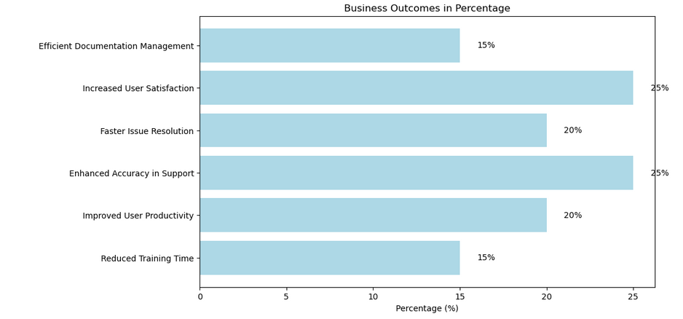
Business Outcomes/ Benefits (along with any KPIs)

Slide 10
Key Performance Indicators (KPIs):
Chatbot Usage Metrics:
KPI: Number of interactions with the chatbot.
Objective: Monitor the adoption and usage of the chatbot to ensure that it is actively utilized by project team members.
Query Resolution Time:
KPI: Average time taken to respond to user queries.
Objective: Measure the chatbot's efficiency in providing quick and timely responses to user inquiries.
Accuracy Rate:
KPI: Percentage of accurate responses.
Objective: Evaluate the chatbot's ability to provide correct and context-specific information, reducing the likelihood of errors.
Training Time Reduction:
KPI: Percentage decrease in user training time.
Objective: Assess the impact of the chatbot on reducing the time spent on traditional user training sessions.
User Satisfaction Score:
KPI: Survey results and feedback ratings.
Objective: Measure user satisfaction through surveys and feedback to ensure that the chatbot meets user expectations and enhances the overall user experience.
Documentation Access Metrics:
KPI: Frequency of accessing project documentation.
Objective: Monitor the accessibility and utilization of project documentation through the chatbot to ensure efficient documentation management.

Slide 11
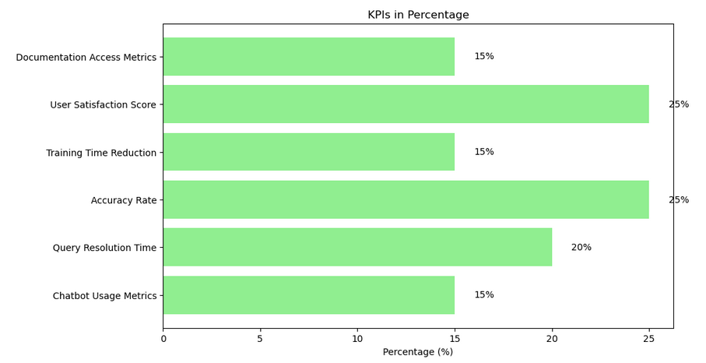
Business Outcomes/ Benefits (along with any KPIs)

Slide 12

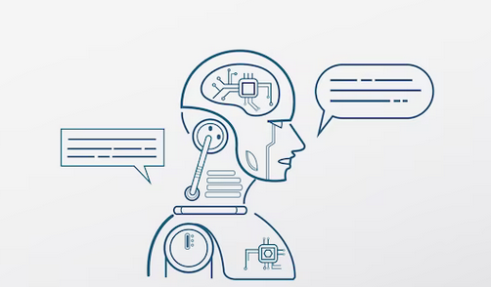
Intelligent Project Support Chatbot for TRIRIGA Implementation
THANK YOU ☺
AI-Enhanced Multi-Step Energy Usage Forecasting (AI-EMEU)
GIC Gen AI: Techathon 2023
GIC Gen AI: Techathon 2023
Nitin DH | IBM Consulting India | E- nhambir1@in.ibm.com | Direct - +91-9758914444.
Nitin DH | IBM Consulting India | E- nhambir1@in.ibm.com | Direct - +91-9758914444.

